Slide 1
About the Course
The long 20th century will in all likelihood be seen in the future as the watershed in human experience:
Nine aspects:
History was primarily economic—and that was true for the first time…
Explosion of wealth: 2%+ per year…
Cornucopia of technology…
Demographic transition…
Feminist revolution…
Empowered tyrannies…
Wealth gulfs…
Inclusion and hierarchy attenuation…
Mismanagement and insecurity…
Humanity is unlikely to see as transformative—for good and ill, but mostly for good, so far at least, I think—a century again…

Slide 2
Coronavirus!
Calls are Carol Christ’s…
She has made the call: classes are now moved online: I am busy adding audio to slide files
That said:
If you are coughing and sneezing, stay home! Email me and we will give you extra-credit points…
Otherwise, there are powerful herd-animal benefits to coming to lecture
(& to talking about course material with your friends: you need to convince your brain that these concepts are useful, & it should keep them)
Washington State has been doing an intensive flu screening, so they know stuff:
They guess: 1 in 1000 people in WA has coronavirus right now
Half of them have no symptoms
Asymptomatic transmission means that we cannot contain this without shutting society down
Cases doubling every 5 days
Means that by the end of March 1 in 45 people in WA will have it…
April will be epidemic month
In the end, 30%-70% of us will test positive
&, worldwide, 20 million people are likely to be dead
Our hope is to stretch out this process as long as possible, so that health providers are not totally overwhelmed

Slide 3
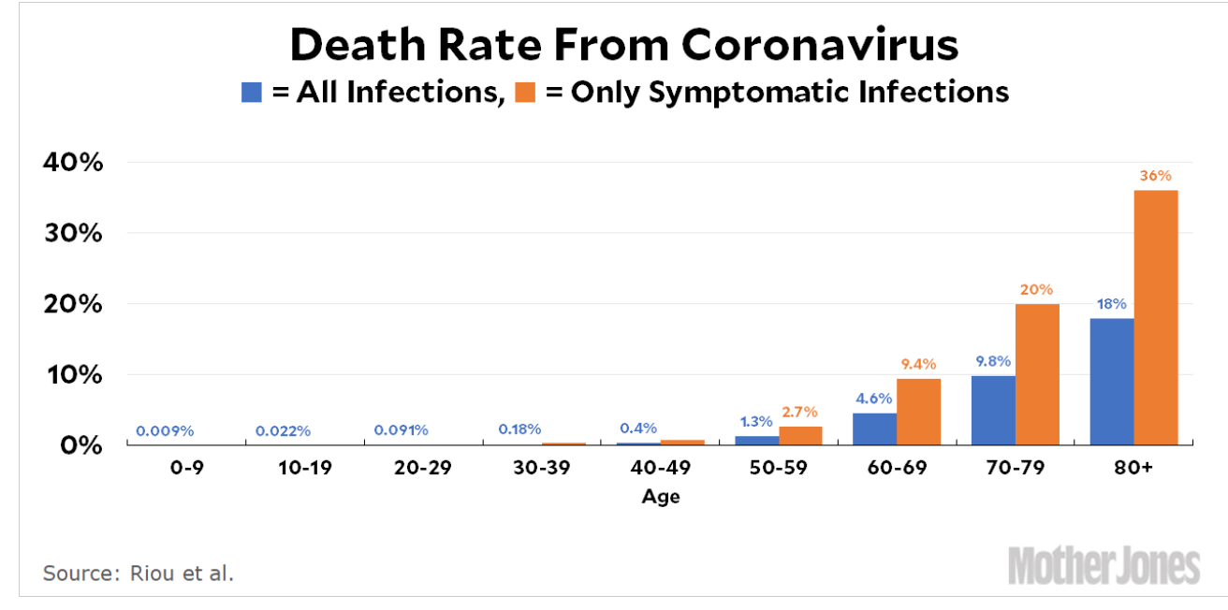
MOAR Coronavirus!
It’s a Thing for Geezers!
Mortality for the Youngs very low…
It’s the flu for them…

Slide 4
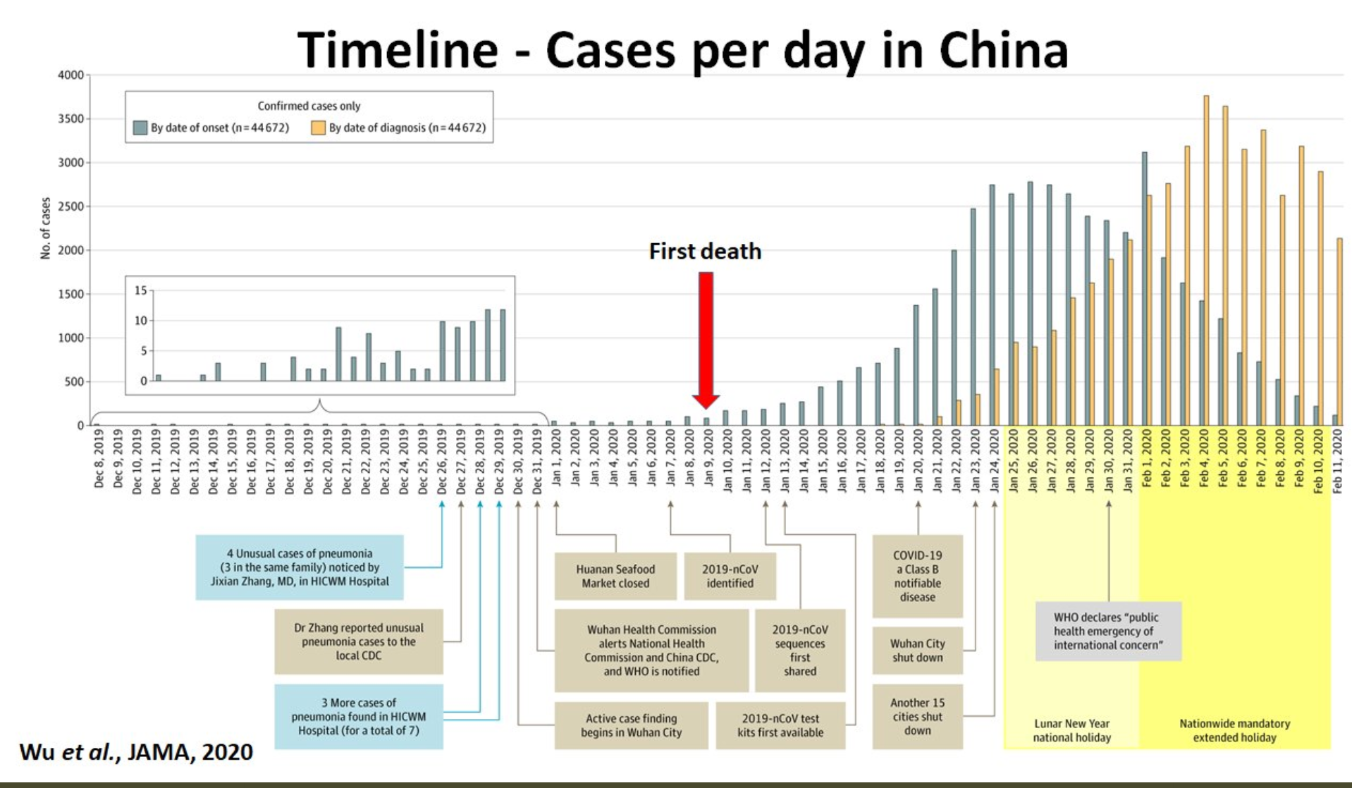
MOAR Coronavirus! II
China Beat It!
Shut down Wuhan when 200 cases per day
That seems to have been a good decision

Slide 5

MOAR Coronavirus! III
When Is It Appropriate to Move on This?
Immediate social distancing…
Self-isolate if you have a cough and a fever…
Hope that warmer temperatures will do to this what they did to SARS…
Otherwise, when do you want to start spreading out transmission. It seems that early is as good as later…

Slide 6
U.C. Berkeley: Economics 115: Spring 2020
20th Century Economic History: Lecture 10: Cold War
Brad DeLong
Department of Economics and Blum Center, U.C. Berkeley; and WCEG
delong@econ.berkeley.edu
last revised: 2020-03-09
for delivery: M 2020-03-09 17:00 HMMB390
<https://bcourses.berkeley.edu/courses/1487684>
<https://github.com/braddelong/public-files/blob/master/econ-115-lecture-10.pptx>

Slide 7
Takeaways from Last Time
From Fascism & WWII
Come up with your own five takeaways from our look at interwar (between World Wars I & II) fascism and World War II…

Slide 8
Preview
The Cold War
Takeaways from Last Time
Preview
Administration
The Cold War: There Was Not Supposed to Be One
The Korean War
Review: Broad sweep
Consequences: After the Korean War
Russia Sits Down
Takeaways
Preview

Slide 9
Econ 115: Administration: Office Hours &c.
DeLong: Office Hours
M 11:10-12:40, Blum Hall 200B
T 11:15-12:00, Blum Hall 200B
Email <delong@econ.berkeley.edu> for a virtual appointment
Read: DeLong, chapter 15
Slides: <https://github.com/braddelong/public-files/blob/master/econ-115-lecture-10.pptx>
Do: Assignments on suspension as we figure out what to do with the midterm…
Memo: bCourses website <https://bcourses.berkeley.edu/courses/1487684>

Slide 10
Reminding You:
In the abortive German communist revolution of January 1919, Petty Officer Lemmgen and his forces failed to take control of the offices of the Ministry of War because:
Lieutenant Hamburger objected that the document authorizing him to do so was handwritten, and Lemmgen returned to Revolutionary HQ to get the document typed.
Lieutenant Hamburger objected that the document authorizing him to do so was not signed, and Lemmgen returned to Revolutionary HQ to get the document signed.
Lieutenant Hamburger objected that the Revolutionary Council that had produced the document was a bunch of traitors.
Lieutenant Hamburger objected that the Revolutionary Council was only made up of a minority of the leaders of the German Socialist Party.
None of the above.

Slide 11
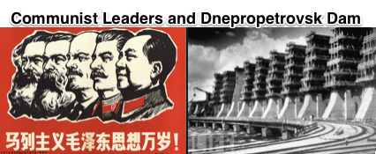

How Important Was the Soviet Union for Twentieth Century Economic History?
How much time should I spend on the Soviet Union in this class?
A dead end
Very important outside the United States…
Not terribly important for America…
Socialism never got anywhere in America—Jack London: not proletarians but “temporarily embarrassed millionaires”
Virginia and Kentucky nationalism strongly opposed to “big government”
New-England nationalism not strongly in favor
Cold War very important for America, however…
1:30
Notes:
How much time should I devote to the Soviet Union in this 20th-century Economic History class? The Soviet union—and much more so Maoist China—plus their empires were an off a lot of people, and really existing socialist regimes ruled fro generations. But they were not models of development or the roads to the future, but rather horrible warnings and dead ends. Moreover, really existing socialism was never very popular in the United States. It was too close to being an obvious tool of Russian foreign policy imperialism. All forms of socialism were working against the grain in the United States: as Jack London said, in the United States we had no proletarians but rather everybody was a temporarily embarrassed millionaire. The Virginia and the Kentucky nationalisms of America were strongly opposed to "big government", And the Massachusetts nationalism plays to much too much stress on the individual conscience and on marching toward utopia listening to your own personal drummer for the regimentation to be a positive.
But the cold war from 1947 to 1989 was very important to America into the world. So let me focus on the Cold War.

Slide 12
There Was Not Supposed to Be a Cold War
Leninist theory was very clear:
Capitalism needed imperialism to moderate crises
Imperialism led to intra-imperialist war
War led to the advance of socialism
Hence step back, rebuild, wait for the Anglo-American War, & then cash in your chips…
That ought to have been Stalin’s plan…
2:25
Notes:
The Cold War was the 1947-1989 largely peaceful contest for global influence and predominance between the United States and the Soviet Union. There was not supposed to be a Cold War. Marxist theory—at least that branch of Marxist theory that became the cultic revealed religion guiding at least the official pronouncements of the governments ruling from behind Stalin's Iron and Mao’s Bamboo Curtains—was very clear on what was to come:
Capitalism, in Lenin’s view, needed imperialism. Imperialism produced militarization with its enormous demand for weapons and colonies that offered captive markets. These were essential to preserve near-full employment, and so stave off the catastrophic economic crises—like the Great Depression—that would otherwise produce communist revolution. But imperialism also produced war. Thus capitalism was staving off revolution from economic catastrophe by courting revolution through political-military catastrophe.
As Lenin’s successor Stalin saw it, the capitalist-imperialist powers had successfully delayed revolution from the late 1890s though imperialism and militarism, but had then fallen into the catastrophe of World War I. That had brought Lenin to power in Russia. Then the rise of fascism—Mussolini in Italy, Hitler in Germany, Franco in Spain, Petain in France, Tojo in Japan—led to the second great imperialist war, World War II, worse than the first. In the aftermath really existing socialism expanded across Europe to the Elbe and the Adriatic—although not before Hitler’s legions had nearly destroyed the Soviet Union.
Thus their task after World War II were to build up militarily to defend the territories of really existing socialism, to build up economically to realize the promise of socialism and to demonstrate its superiority to capitalism, stand ready to assist socialist revolutions, and otherwise lie low.
If they accomplished those tasks, then the logic of imperialist-militarist-capitalism would start to work again. Provided the really existing socialist block kept its head down and survived, it would expand again after the next intra-imperalist war. That ought to have been the Soviet Union’s strategy: defend, rebuild, and wait, for history was on their side. Waging a cold war was not the strategy.

Slide 13
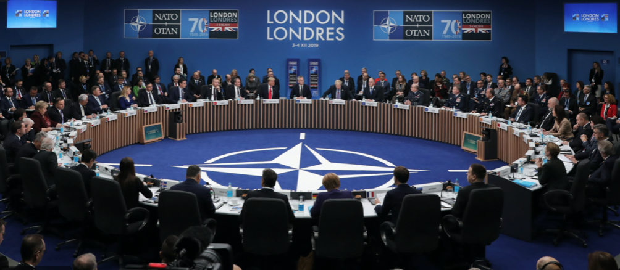
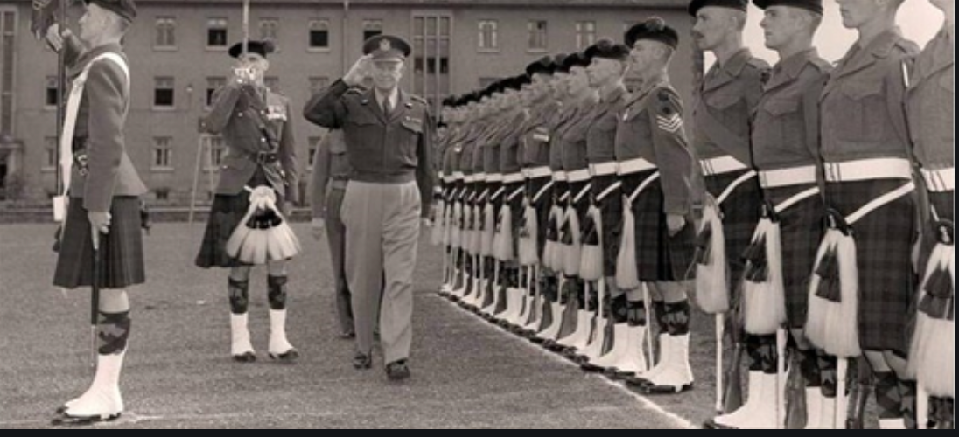
The NATO Alliance Did Not Want a Cold War Either
Post-WWII demobilization
Isolationism
The “West” saw itself as secure
Post-WWII opposition to the Marshall Plan, etc.
Stalin’s patience
But Czechoslovakia
And Mao
The U.S. military’s wish list: NSC-68
2:26
Notes:
On the other side of what was to become the Iron Curtain, there was little appetite for confrontation. Isolationist currents in America were not as strong as they had been after World War I, but they were strong. Western Europe was exhausted. Britain was seeking to find a role, rather than wishing to roll back really-existing socialism. A U.S. General Patton might muse about taking his 3rd Army’s tanks and driving to Moscow, but that was far beyond the pale for any sane and most other North Atlantic politicians. Militarism to send millions of young men to die at the front while civilians died under bombing was in bad odor.
West of what was to become the Iron Curtain, really-existing socialism was not very attractive. Cadres had been decimated at the start of World War II by the Stalin-Hitler pact. And really-existing socialism became more unattractive the more closely outsiders were able to scrutinize it. Pus it ran into the buzzsaw of nationalism. It became more and more clear that allegiance to really-existing socialism required submission to or absorption into the latest incarnation of Russian Empire.
Stalin had a taste for snatching up territory when he thought it could be taken cheaply—starting with the suppression of the Mensheviks in Georgia at the end of the Russian Civil War. But after World War II Stalin curbed his appetite. He did not impose a really-existing socialist government on Finland, but let it remain democratic as long as it was disarmed and joined no potentially anti-Soviet alliances—and as long as its government was riddled with Soviet agents. He cut off support to the communist party in Greece—largely. He counseled Mao to join a coalition with Chiang Kai-shek (the Cantonese romanization of Jiang Jieshi) and wait.
But in 1948 Stalin could not resist snatching up Czechslovakia in a coup d’etat. And Mao ignored Stalin, defeated Chiang Kai-shek, and chased him and his Guomindang to Taiwan. No doubt Stalin heard whispers that he was being overly cautious, and had lost his nerve as a result of the shocks of World War II. The U.S. government had plans to wage a cold war—boosting defense spending to 10% of national income and deploying U.S. armies as tripwires and more-than-tripwires all across the globe. But those plans remained fantasies for unimaginable contingencies—until the Korean War.

Slide 14
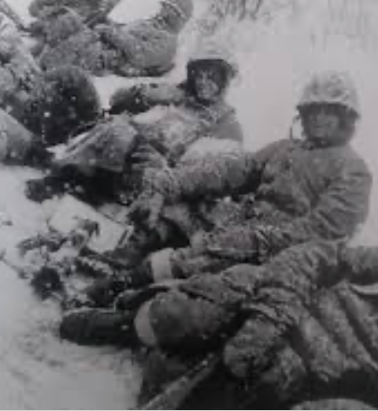
The Korean War
The U.S. right wing was conflicted
Post-WWII opposition to the Marshall Plan, etc.
Yet, also: fight Mao! Unleash Chiang Kai-Shek! McCarthyism!
Isolationism abroad, plus red-baiting at home
But Stalin could not stick to his plan…
North Korea and Kim Il Sung…
Chinese intervention
2:26
Notes:
Stalin could not stick to his plan. In 1950 the strongman Kim Il Sung, whom Stalin had installed in North Korea at the end of World War II when the Russians occupied the north off the country above and the Americans occupied the south below the 38th parallel, begged him for tanks and support to take over the south. There were then no U.S. garrisons in the south. The U.S. had declined to send troops to support Chiang Kai-shek—it had sent weapons, but had stopped when it realized that the most effective way to arm Mao’s People’s Liberation Army was to ship weapons of the Guomindang. Moreover, the U.S. was for decolonization—the British out of India, the Dutch out of Indonesia. While the U.S. was happy to provide logistical support to the French war against the communist Vietminh in southeast Asia, it wanted the French to promise independence rather than further colonial rule as the endpoint. U.S. strategic thinking was that in Asia it should use air and sea rather than land power as its weapons.
In June 1950 Stalin let slip the dog of war that was Kim Il Sung and his Soviet-trained and supplied army. The Korean War began, as the U.S. surprised Kim Jong Il, Stalin, Mao, and itself by rallying the United Nations to send an army, largely provided by the United States but formally a force of the United Nations as an organization, to defend the order that had been established in the American zone of occupation that was to become South Korea—and perhaps create a single unified Korean nation as well.
Fighting raged all across the Korean peninsula, from near the Yalu River in the north to the port of Pusan in the south. South Koreans and North Koreans fought on land; Americans fought on land, in the sea, and in the air; Chinese fought on land; Russians fought in the air (with 350 planes shot down). In three years, somewhere between one and two million Korean civilians died, 5% to 10% of the population; perhaps 400000 South Koreans were abducted from their homes and taken to North Korea; and the military dead and missing were, roughly: 500000 Chinese, 300000 North Koreans, 150000 South Koreans, 50000 Americans, 1000 British, 1000 Turkish, 500 Canadian, 400 Australian, 300 Russian, 250 French, 200 Greek, 150 Columbian, 130 Thai, 120 Ethiopian, 120 Dutch, 100 Belgian, 90 Filipino, 30 South African, 30 New Zealand, 3 Norwegian, 2 Luxembourgese, and 1 Indian soldier. The U.S. Air Force dropped half a million tons of bombs during the war—that is 40 pounds of bomb for every North Korean then alive.
The United States did not use its nuclear weapons—it was a war, but it was a limited war. U.S. theater of operations commander Douglas MacArthur asked for their use at the end of 1950 when Chinese People’s Liberation Army attacks forced the United Nations’ army to retreat from near the Yalu River back to south of Seoul. The Pentagon and U.S. President Harry Truman refused. Starting in March 1951, with the battlefront stabilized near the 38th parallel that had divided North and South Korea before the war, the Pentagon and Truman began to seek a ceasefire and a return to the status quo ante bellum—to the state of things before the war—leaving neither victor nor vanquished.
Yet the war dragged on for two more years. And the casualties mounted: military comm https://www.britannica.com/event/Korean-War/North-to-the-Yalu anders on both sides thought that leverage at the peace table was to be gained by attritting their adversary’s forces and depriving them of jumping-off points in case the war was widened. Key, in the minds of United Nations commanders Matthew Ridgway and James van Fleet, was the “Iron Triangle” about 12 miles on each side, near the 38th parallel, running from Pyonggang in the north to Kimhwa in the east to Chorwon in the west.
The ultimate sticking point in the negotiations, however, was the status of prisoners of war. The Chinese and North Koreans wanted all prisoners of war returned to their countries of origin. The United Nations and the South Koreans wanted to keep prisoners of war who wished not to return from being forced to do so. On March 5, 1953, Soviet Dictator Josef Stalin died of a stroke. Stalin’s heirs decided that the Korean War was pointless and should end. Mao’s negotiators accepted the United Nations’s prisoner-of-war position. 10000 of 15000 Chinese prisoners of war decided not to return to China 5000 or 70000 North Korean prisoners of war decided not to return to North Korea. 327 South Korean prisoners of war decided to stay in North Korea, as did 21 Americans and 1 Briton. 18 of the 22 eventually returned to the western bloc. However 8000 missing from the United Nations forces (and 80000 missing from the South Korean forces) remained unaccounted for. Most of them surely died in battle, but…
And so the current state of things—with North Korea under the autocratic rule of the current Kim dynasty which has presided over the worst famine of the post-World War II period, and with South Korea independent and now a rich industrial power and a democracy—began.

Slide 15
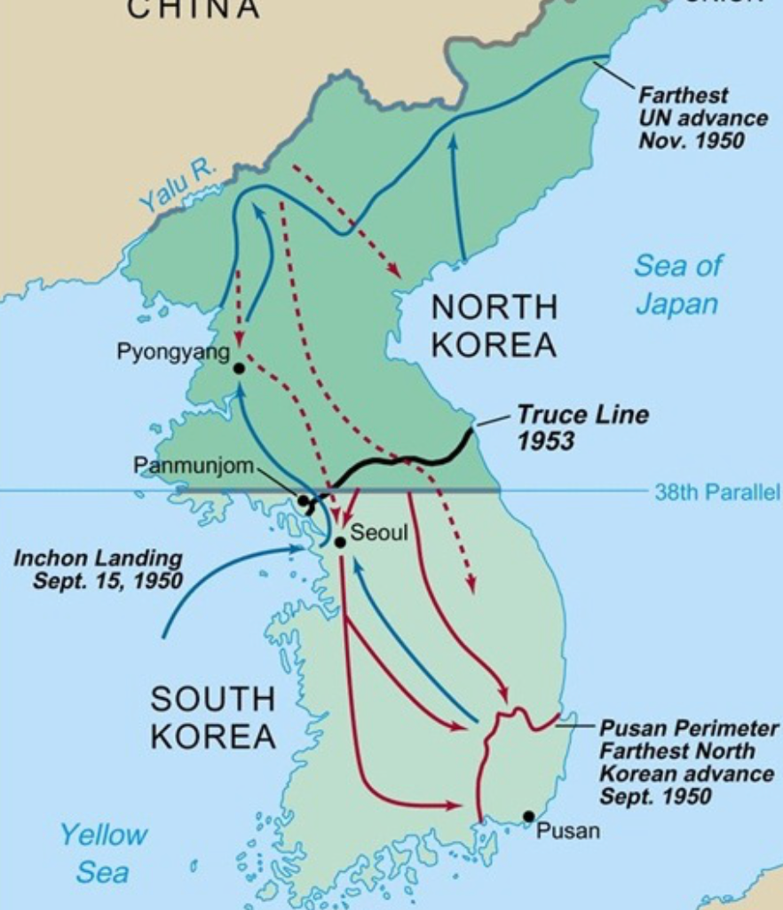
The Korean War
No U.S. use of nuclear weapons
A limited war
Dismissal of U.S. commander MacArthur
Sought a return to the status quo ante
The war dragged on…
The U.S. response and NSC-68
10% of GDP in military…
War dragged on for three years
Settlement as essentially a return to the status quo ante bellum
2:34
Notes:
Stalin could not stick to his plan. In 1950 the strongman Kim Il Sung, whom Stalin had installed in North Korea at the end of World War II when the Russians occupied the north off the country above and the Americans occupied the south below the 38th parallel, begged him for tanks and support to take over the south. There were then no U.S. garrisons in the south. The U.S. had declined to send troops to support Chiang Kai-shek—it had sent weapons, but had stopped when it realized that the most effective way to arm Mao’s People’s Liberation Army was to ship weapons of the Guomindang. Moreover, the U.S. was for decolonization—the British out of India, the Dutch out of Indonesia. While the U.S. was happy to provide logistical support to the French war against the communist Vietminh in southeast Asia, it wanted the French to promise independence rather than further colonial rule as the endpoint. U.S. strategic thinking was that in Asia it should use air and sea rather than land power as its weapons.
In June 1950 Stalin let slip the dog of war that was Kim Il Sung and his Soviet-trained and supplied army. The Korean War began, as the U.S. surprised Kim Jong Il, Stalin, Mao, and itself by rallying the United Nations to send an army, largely provided by the United States but formally a force of the United Nations as an organization, to defend the order that had been established in the American zone of occupation that was to become South Korea—and perhaps create a single unified Korean nation as well.
Fighting raged all across the Korean peninsula, from near the Yalu River in the north to the port of Pusan in the south. South Koreans and North Koreans fought on land; Americans fought on land, in the sea, and in the air; Chinese fought on land; Russians fought in the air (with 350 planes shot down). In three years, somewhere between one and two million Korean civilians died, 5% to 10% of the population; perhaps 400000 South Koreans were abducted from their homes and taken to North Korea; and the military dead and missing were, roughly: 500000 Chinese, 300000 North Koreans, 150000 South Koreans, 50000 Americans, 1000 British, 1000 Turkish, 500 Canadian, 400 Australian, 300 Russian, 250 French, 200 Greek, 150 Columbian, 130 Thai, 120 Ethiopian, 120 Dutch, 100 Belgian, 90 Filipino, 30 South African, 30 New Zealand, 3 Norwegian, 2 Luxembourgese, and 1 Indian soldier. The U.S. Air Force dropped half a million tons of bombs during the war—that is 40 pounds of bomb for every North Korean then alive.
The United States did not use its nuclear weapons—it was a war, but it was a limited war. U.S. theater of operations commander Douglas MacArthur asked for their use at the end of 1950 when Chinese People’s Liberation Army attacks forced the United Nations’ army to retreat from near the Yalu River back to south of Seoul. The Pentagon and U.S. President Harry Truman refused. Starting in March 1951, with the battlefront stabilized near the 38th parallel that had divided North and South Korea before the war, the Pentagon and Truman began to seek a ceasefire and a return to the status quo ante bellum—to the state of things before the war—leaving neither victor nor vanquished.
Yet the war dragged on for two more years. And the casualties mounted: military comm https://www.britannica.com/event/Korean-War/North-to-the-Yalu anders on both sides thought that leverage at the peace table was to be gained by attritting their adversary’s forces and depriving them of jumping-off points in case the war was widened. Key, in the minds of United Nations commanders Matthew Ridgway and James van Fleet, was the “Iron Triangle” about 12 miles on each side, near the 38th parallel, running from Pyonggang in the north to Kimhwa in the east to Chorwon in the west.
The ultimate sticking point in the negotiations, however, was the status of prisoners of war. The Chinese and North Koreans wanted all prisoners of war returned to their countries of origin. The United Nations and the South Koreans wanted to keep prisoners of war who wished not to return from being forced to do so. On March 5, 1953, Soviet Dictator Josef Stalin died of a stroke. Stalin’s heirs decided that the Korean War was pointless and should end. Mao’s negotiators accepted the United Nations’s prisoner-of-war position. 10000 of 15000 Chinese prisoners of war decided not to return to China 5000 or 70000 North Korean prisoners of war decided not to return to North Korea. 327 South Korean prisoners of war decided to stay in North Korea, as did 21 Americans and 1 Briton. 18 of the 22 eventually returned to the western bloc. However 8000 missing from the United Nations forces (and 80000 missing from the South Korean forces) remained unaccounted for. Most of them surely died in battle, but…
And so the current state of things—with North Korea under the autocratic rule of the current Kim dynasty which has presided over the worst famine of the post-World War II period, and with South Korea independent and now a rich industrial power and a democracy—began.

Slide 16
Review: Broad Sweep
What was the growth rate of ideas in the industrial core of the world economy over 1870-2020?
About 2.3%/year
About 0.9%/year
About 0.23%/year
About 4%/year
None of the above

Slide 17
Review: Broad Sweep
What was the growth rate of ideas in the industrial core of the world economy over 1770-1870?
About 2.1%/year
About 0.45%/year
About 0.15%/year
About 0.04%/year
None of the above

Slide 18
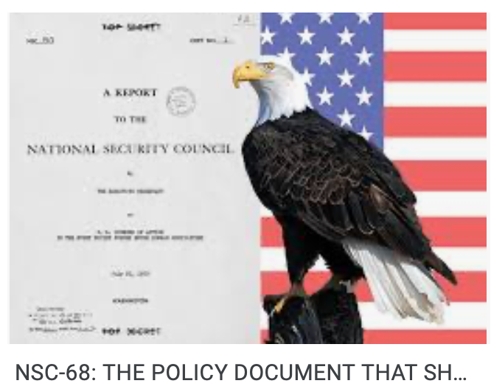
Consequences: After the Korean War
NSC-68
10% of GDP in military…
Western Germany looked a lot like South Korea
A full U.S. army in Europe
Containment
Projecting power
2:29
Notes:
n the aftermath of the Korean War, the United States saw itself as having a new role.
To start with, western Germany looked analogous to Korea—a country divided by what had originally been intended to he a military occupation boundary but had become permanent. That it could not be snatched up cheaply was not wholly reassuring, because Stalin had also exhibited a certain degree of bad judgment: in addition to allowing Kim Il Sung to launch the Korean War, there was the unsuccessful attack on Finland in 1939, and there was mother of all miscalculations, the belief that the way to deal with Hitler was to become his ally and then watch Nazi Germany and the western democracies exhaust themselves in trench warfare. Perhaps Stalin’s successors would exhibit a similar appetite for conquest on the cheap, and a similar weak grasp of geopolitical realities.
As a result of the Korean War, by the middle of the 1950s there was a full U.S. army—corps, divisions, airwings, and the standard enormous logistical tail—sitting in West Germany waiting for Stalin’s successors to attempt in Germany what Stalin, Mao, and Kim Il Sung had attempted in Korea: the reunification by force of a country that had been divided in the armistice that ended World War II. Stalin’s successors were largely unknown: the only solid thing about them was that they had flourished under Stalin and shot a couple of their own number in the power struggle that followed Stalin’s death. By the mid-1950s the U.S. was spending on the Cold War a huge scale. What had before June 1950 been the fantasies of national security staffers and planners became reality. They pushed U.S. national security spending up to 10% of national income after the Korean War had come to an end provided a strong floor to demand and employment in the United States as well.
A good deal of this spending was for the U.S. to project its Cold War military power far beyond its borders. U.S. bases and troops found themselves permanently deployed on every continent save Antarctica. Roughly three-quarters of a percent of U.S. national product in the mid 1950s was “net military transactions”—expenditures abroad by the U.S. army which generated no dollar inflow. In Europe, the increase in net U.S. military transactions did much to offset the winding-down of the Marshall Plan: the forces of the Supreme Allied Commander, Europe, of the North Atlantic Treaty Organization thus provided one more secure source of demand for European production during Europe’s booms in the 1950s and 1960s.

Slide 19
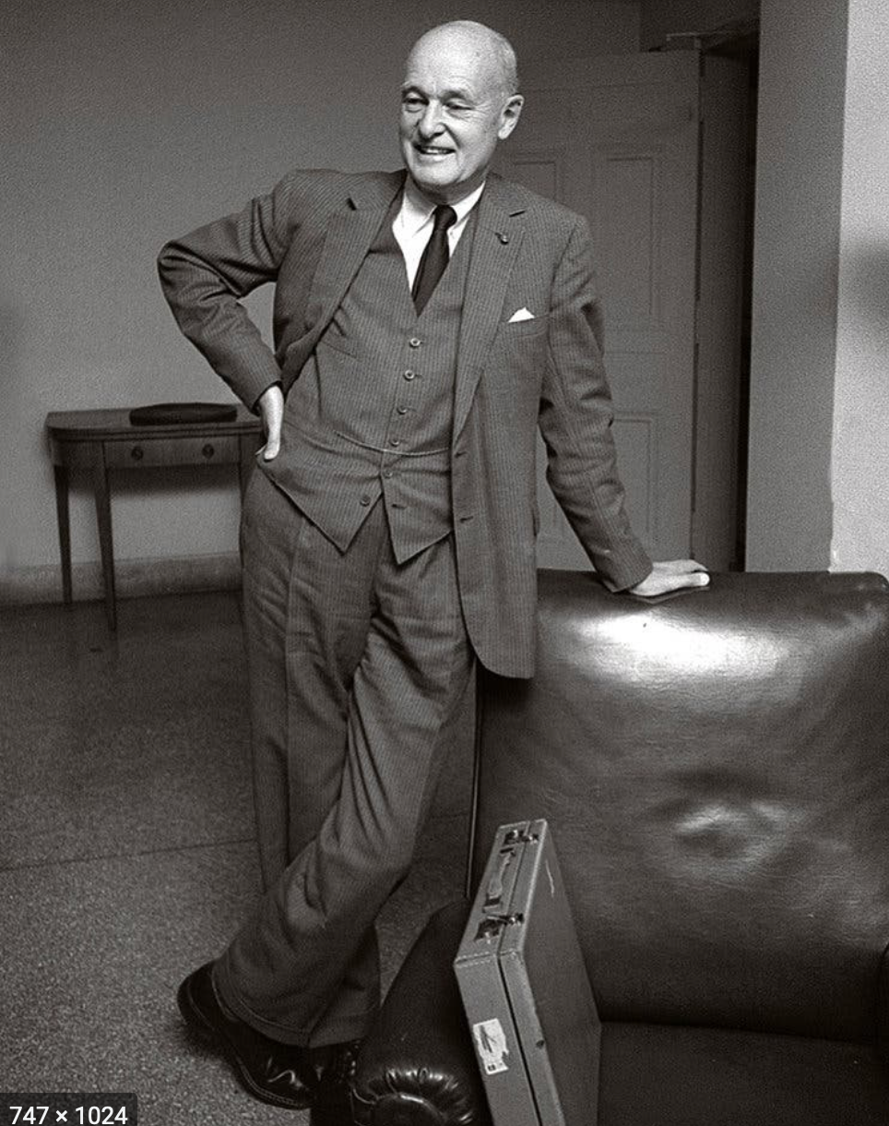
Containment and Destabilization
Containment
Projecting power
Destabilization
Defensive weapons can look pretty offensive
“Peaceful coexistence”
Soviet hopes
George Kennan
Meet force with resistance
Play the long game
A suitable challenge for America to face with confidence
Become and remain a City Upon a Hill
2:29
Notes:
Nuclear forces that U.S. planners regarded as perhaps inadequate to deter a Russian nuclear strike or conventional-force invasion of western Europe struck Russian planners as dangerously close to the forces the U.S. would need to wage and win a nuclear devastation or conventional occupation of Russia. And all Russian planners remembered the burning of Moscow by the Crimean Tartars in 1571, the occupation of Moscow by the Poles in 1610, the invasion by the Swedes in 1709, the occupation of Moscow by the French in 1812, the German-dictated Peace of Brest-Litovsk in 1918, and Hitler’s invasion in 1941. From 1956 on the formal policy of the Soviet Union was “peaceful coexistence”. The Russians would, of course, continue to support just revolts against colonialism and capitalism. But war between the superpowers? Off the table. The U.S. and the U.S.S.R. would coexist. Really existing socialism would triumph in the end, of course. But its triumph would be by example, not by military force.
From the other side of the hill, the U.S. policy became one of “massive retaliation”: “contain[ing] the mighty landpower of the communist world… by be[ing] willing and able to respond vigorously at places and with means of its own choosing”. This policy, pointedly, did not take a nuclear-weapon response to a conventional provocation off the table, and did not restrict retaliation and deterrence to the particular theater of conflict.
The keyword, I believe, is “contain”: the U.S. and indeed the western NATO alliance policy for the Cold War was one of containment. As U.S. diplomat George Kennan put it, the right strategy was one of “holding the line and hoping for the best”, for since “ideology convinces the rulers of Russia that truth is on their side and they they can therefore afford to wait”, it was the case that “Soviet pressure… can be contained by the adroit and vigilant application of counter-force at a series of constantly shifting geographical and political points”.
And there was more: “the issue of Soviet-American relations is in essence a test of the overall worth of the United States as a nation among nations”.
Thus:
>The thoughtful observer of Russian-American relations will find no cause for complaint in the Kremlin's challenge to American society. He will rather experience a certain gratitude to a Providence which, by providing the American people with this implacable challenge, has made their entire security as a nation dependent on their pulling themselves together and accepting the responsibilities of moral and political leadership that history plainly intended them to bear…
If only the United States could, Kennan believed, truly be a City Upon a Hill. If only it could, as John Winthrop had preached back in 1630: “follow the counsel of Micah, to do justly, to love mercy, to walk humbly with our God” so that “he shall make us a praise and glory that men shall say of succeeding plantations, ‘may the Lord make it like that of New England’…”—then the U.S. and the western NATO alliance would have nothing to fear from the Cold War.

Slide 20
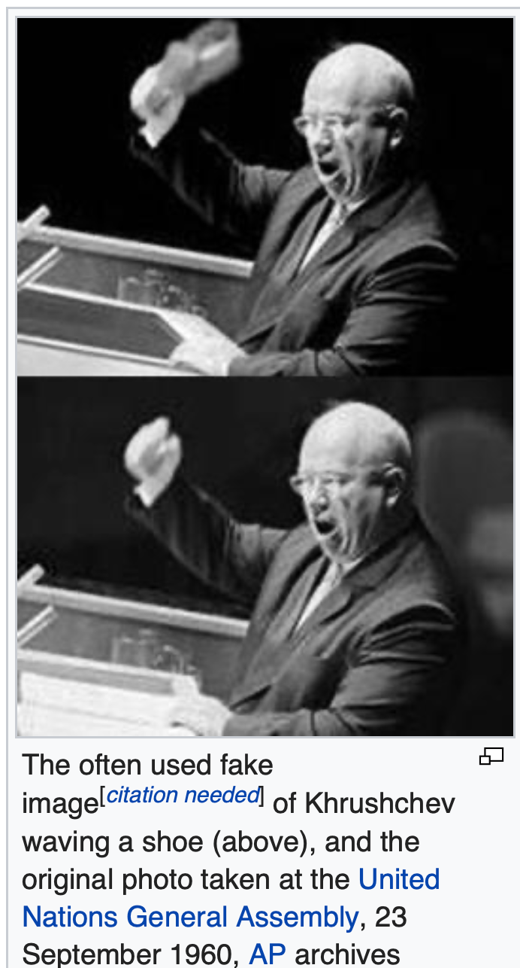
“We Will Bury You”
Containment as American policy
Pursued with confidence
Except possibly by Kissinger
Confidence on the other side: Khrushchev
Nobody in Russia wanted a WWIII
The “Third World”
Opportunities
Nehru, Sukarno, Tito
Threats
Soviet: East Germany, Hungary , Czechoslovakia, Afghanistan in 1978
U.S.: Iran and Guatemala in 1954, Cuba in 1961, Chile in 1973, Nicaragua in 1981, Grenada in 1983.
Cold War turning genuinely hot: Korea (5 million dead), Vietnam (2.5 million dead), Ethiopia (1.5 million dead), Angola (500000 dead), and more.
Governments that attack society: Indonesia, Khmer Rouge
4:17
Notes:
The Americans who ran foreign policy overwhelmingly agreed. The only possible exception was 1969-1976 Secretary of State Henry Kissinger and his erratic boss President Richard Nixon. Kissinger’s international-relations professor colleague Stanley Hoffman believed that “Henry, in his melancholy, seems to walk with the spirit of Spengler at his side”; and Admiral Elmo Zumwalt said that Kissinger talked to him about how America was part of a civilization that had seen its best days and needed to accommodate the rising power of Russia, which was a Peloponnesian War-era “Sparta to our Athens”. The others saw no reason to panic.
Soviet paramount leader Nikita Khrushchev said the same thing, but less… diplomatically, in 1956: “Whether you like it or not, history is on our side. We will bury you.” Probably the Russian “Мы вас похороним” would have been better translated as: “we will be the ones who will dig your grave” or as “we will outlast you”. Later on Khrushchev clarified: “I once said, ‘We will bury you’, and I got into trouble with it. Of course we will not bury you with a shovel. Your own working class will bury you.” The Soviet Union had lost perhaps 27 million people killed and starved in World War II. Nobody in it wanted a World War III.
For leaders and would-be leaders of both independent and colonized nations and nations-to-be during the first post-World War II generation, the Cold War was, more often than not, a blessing. Leaders could press the United States to encourage Britain and France to accelerate decolonization. Before independence, they could observe that if decolonization was delayed, the Russians and the Chinese would use the grievances justly felt by the colonized to build support for insurgencies that would add that nation to the Communist Bloc. After independence, they could declare themselves “nonaligned”, as the movement started at the Bandung Conference in Indonesia by then-Indonesian strongman Sukarno and then-Indian Prime Minister Nehru was called. Nonaligned nations could then call for bids of support from both sides in the Cold War. The hotter and more important the Cold War, the more both sides would be willing to spend to support a nonaligned government that was trying to decide what its political and economic system should be.
On the other hand, the hotter the Cold War, the more likely it was that a government or a popular movement trying to steer its own course would be pulled up short by the choke-chain of one of the superpowers, and people would die. Yugoslavia and Finland managed to pursue their own paths—but the Red Army stepped in to enforce the party line and discipline in East Germany in 1953, in Hungary in 1956, in Czechoslovakia in 1968, Afghanistan in 1978. The U.S. sponsored coups or sent troops to overthrow governments into Iran and Guatemala in 1954, Cuba in 1961, Cuba in 1973, the Dominican Republic Nicaragua in 1981, Grenada in 1983. Plus there were the cases where the Cold War turned genuinely hot: Korea (5 million dead), Vietnam (2.5 million dead), Ethiopia (1.5 million dead), Angola (500000 dead), and more.
And there were governments that attacked their societies because of the Cold War: somewhere between 100,000 and 500,000 of Indonesia’s hundred million were murdered in 1965 in The Year of Living Dangerously, when strongman Suharto used an attempted communist coup as a pretext to sideline previous strongman Sukarno and then slaughter everyone in Indonesia whom anyone said might be a communist. The Khmer Rouge in 1975-9 killed two of Cambodia’s 8 million people for no reason whatsoever—and still China and the U.S. backed the Khmer Rouge against the Cambodian government the Vietnamese installed in 1979. And there were many, many more.

Slide 21
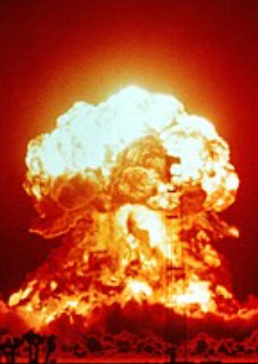
On the Edge of Nuclear Fire
The Cuban Missile Crisis
Missiles in Turkey and Cuba
Blockage
“The knot of war”
U.S. promises—and U.S. politics
Teetering: other episodes:
Mistaking moonrise
Mistaking a solar flare
Training scenarios
Colonel Petrov
KAL 006
The Vincennes
Still, by and large, something like peace
3:16
Notes:
Even more alarmingly, the world teetered on the edge of thermonuclear war during the Cuban Missile Crisis of 1962. Russian paramount leader Nikita Khrushchev was somewhat surprised by the bellicose reaction of American President John F. Kennedy to Russia’s deployment in Cuba of missiles like those the U.S. had previously deployed in Turkey next to Russia’s border. Khrushchev wrote to Kennedy: “We and you ought not now to pull on the ends of the rope in which you have tied the knot of war, because the more the two of us pull, the tighter that knot will be tied. And a moment may come when that knot will be tied so tight that even he who tied it will not have the strength to untie it, and then it will be necessary to cut that knot, and what that would mean is not for me to explain to you, because you yourself understand perfectly of what terrible forces our countries dispose…” The U.S. promised not to overthrow Cuban communist dictator Fidel Castro by force. Russia withdrew its missiles from Cuba. The U.S. withdrew its missiles from Turkey. Both agreed to keep the U.S. withdrawal a secret so as not to create a “Kennedy backed down” campaign issue that the Republicans could use against the Democrats in the 1962 and then 1964 elections. And a lot of misleading histories were written by and based on reports from Kennedy administration insiders over the following two decades.
There were other teeters. In 1960 the moonrise was mistaken by a NATO radar for a nuclear attack—and the U.S. went on high alert even though Russian paramount leader was in New York at the United Nations at the time. In 1967 NORAD thought a solar flare was Soviet radar jamming, and nearly launched its bombers. In 1979 the loading of a training scenario onto an operational computer led NORAD to call the White House, claiming that the U.S.S.R. had launched 250 missiles against the United States, and that the president had only between 3 and 7 minutes to decide whether to retaliate. In 1983 Lieutenant Colonel Stanislav Petrov refused to classify an early warning system missile sighting report as an attack, and dismissed it as an error. And in 1995 Russian President Boris Yeltsin opened his nuclear weapons control briefcase when the launch of a Norwegian northern lights-studying rocket was interpreted as an attack. In 1983 the Red Air Force mistook an off-course Korean airliner carrying 100 people for one of the U.S. RC-135 spy planes that routinely violated Russian air space to test the competence of Russia’s air defenders and shot it down; Red Air Force pilot Gennady Osipovich continues to believe he shot down a spy plane. In 1988 the U.S. Navy cruiser Vincennes—at the time in Iranian territorial waters without Iran’s permission—shot down on on-course Iranian airliner carrying 290 people.
It could have gone very badly indeed. But, compared to 1914-1945, it is only a small exaggeration to say that the world has been at peace since 1945, and continues to be at peace today.

Slide 22
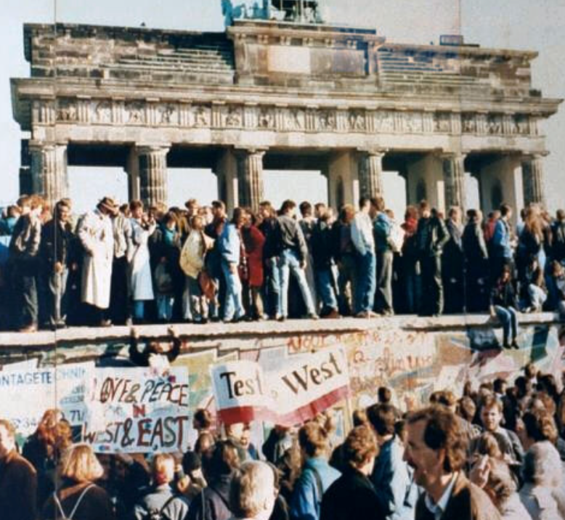
Winners of the Cold War
Khrushchev
His successors concluded that the game was up
Who made a difference?
These who kept the Cold War from getting hot
Those who persuaded others it was over
Those who worked to make the Western Alliance its beat self
My list of ten:
Harry Dexter White; George Kennan; George Marshall; Arthur Vandenberg; Paul Hoffman; Dean Acheson; Harry S Truman; Dwight D. Eisenhower; Gerald Ford; George Shultz
6:18
Notes:
In one sense, Nikita Surgeyevitch Khrushchev was a winner in the Cold War. In 1959 he wrote:
>The socialist states… ruled by the working people.... To them war spells grief and tears, death, devastation and misery. Ordinary people have no need for war.... Peaceful coexistence does not mean merely living side by side... with the constantly remaining threat of [war] breaking out in the future. Peaceful coexistence can and should develop into peaceful competition for the purpose of satisfying man's needs in the best possible way.... Let us try out in practice whose system is better, let us compete without war. This is much better than competing in who will produce more arms and who will smash whom. We stand and always will stand for such competition as will help to raise the well-being of the people to a higher level.... We may argue, we may disagree with one another. The main thing is to keep to the positions of ideological struggle, without resorting to arms in order to prove that one is right.... With military techniques what they are today, there are no inaccessible places in the world. Should a world war break out, no country will be able to shut itself off from a crushing blow.... Ultimately that system will be victorious on the globe which will offer the nations greater opportunities for improving their material and spiritual life...
Khruschchev would have been surprised that, by 1990, it was clear even to his successors sitting in the Kremlin that really-existing socialism was a dead end for humanity. But that was the conclusion people reached. The Cold War was kept from becoming hot, and ended the way Khrushchev had hoped, with one system offering clearly greater opportunities for improving material and spiritual life.
The Cold War could have ended otherwise. People could and did make a difference. Those who made the most different were, I think, those who (a) kept the Cold War from getting hot, (b) persuaded many who wanted to keep fighting it that it was over, and (c) worked hardest to make the social democratic western alliance its best self. Here is my list of the ten outside the Iron Curtain who I think did most to make it so:
Harry Dexter White: Treasury Assistant Secretary who was the major force behind the Bretton Woods Conference and the institutional reconstruction of the post-World War II world economy. He accepted enough of John Maynard Keynes's proposals to lay the groundwork for the greatest generation of economic growth the world has ever seen. It was the extraordinary prosperity set in motion by the Bretton Woods' System and institutions--the "Thirty Glorious Years"--that demonstrated that political democracy and the mixed economy could deliver and distribute economic prosperity.
George Kennan: Author of the "containment" strategy that won the Cold War. Argued--correctly--that World War III could be avoided if the Western Alliance made clear its determination to "contain" the Soviet Union and World Communism, and that the internal contradictions of the Soviet Union would lead it to evolve into something much less dangerous than Stalin's tyranny.
George Marshall: Architect of victory in World War II. Post-World War II Secretary of State who proposed the Marshall Plan, another key step in the economic and institutional reconstruction of Western Europe after World War II.
Arthur Vandenberg: Leading Republican Senator from Michigan who made foreign policy truly bipartisan for a few years. Without Vandenberg, it is doubtful that Truman, Marshall, Acheson, and company would have been able to muster enough Congressional support to do their work.
Paul Hoffman: Chief Marshall Plan administrator. The man who did the most to turn the Marshall Plan from a good idea to an effective aid program.
Dean Acheson: Principal architect of the post-World War II Western Alliance. That Britain, France, West Germany, Italy, and the United States reached broad consensus on how to wage Cold War is more due to Dean Acheson's diplomatic skill than to any single other person.
Harry S Truman: The President who decided that the U.S. had to remain engaged overseas--had to fight the Cold War--and that the proper way to fight the Cold War was to adopt Kennan's proposed policy of containment. His strategic choices were, by and large, very good ones.
Dwight D. Eisenhower: As first commander-in-chief of NATO, played an indispensable role in turning the alliance into a reality. His performance as President was less satisfactory: too many empty words about "rolling back" the Iron Curtain, too much of a willingness to try to skimp on the defense budget by adopting "massive retaliation" as a policy, too much trust in the erratic John Foster Dulles.
Gerald Ford: In the end, the thing that played the biggest role in the rise of the dissident movement behind the Iron Curtain was Gerald Ford's convincing the Soviet Union to sign the Helsinki Accords. The Soviet Union thought that it had gained worldwide recognition of Stalin's land grabs. But what it had actually done was to commit itself and its allies to at least pretending to observe norms of civil and political liberties. And as the Communist Parties of the East Bloc forgot that in the last analysis they were tyrants seated on thrones of skulls, this Helsinki commitment emboldened their opponents and their governments' failures to observe it undermined their own morale.
George Shultz: Convinced Ronald Reagan—correctly—that Mikhail Gorbachev's "perestroika" and "glasnost" were serious attempts at reform and liberalization, and needed to be taken seriously. Without Shultz, it is unlikely that Gorbachev would have met with any sort of encouragement from the United States--and unlikely that Gorbachev would have been able to remain in power long enough to make his attempts at reform irreversible.

Slide 23
The Soviet Union: An Example of “Late Development”?
If you compare the Soviet Union to non-European non-settler economies…
It does quite well—butcher’s bill aside
And it won WWII
How to reconcile these?
Neocolonial origins of comparative development?
I think not—but it is an open question
And foundations for subsequent growth laid during Stalin/Mao?
1:56
Notes:
If we assess the economy of the Soviet union in very narrow terms, considering it as a non-European non-settlement economy, it looks as though it does rather well. It moves people from the farm to the factory. It puts them to work in the factories. It builds the utility, transportation, and urban infrastructure needed to hold a modern industrial society together. Its overall level of productivity is very low. And the level of consumption it supplies to its people is vastly lower than should be generated by its industrial plant.
And it won World War II.
But there is the butcher's bill: killing people in the tens of millions is not necessary, desirable, or in any sense something that belongs on any road to economic development.
Do we think that the Soviet Union—butcher's bill aside—followed the only path that a non-European non-settler economy could follow in the middle 1900s given that the North Atlantic and the imperialist global economy had closed off other roads? I think not. For one thing, Japan shows that other roads were possible. For another, the convergence of post-WWII peripheral western Europe owes much more to good social democratic developmental institutions than to any "neocolonial" boost given to them by the United States.
If we wanted to look for silver linings, we might argue that foundations were laid under Stalin/Mao for further growth under a different system later: the mobilization of resources from a very poor economy for investment was undertaken. But I would not like to lean too heavily on that argument.

Slide 24
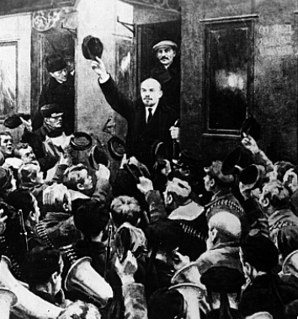
The Trajectory
Imperatives
Survive
Eliminate large-scale private property and market
Industrialize
No aid coming from Germany
War Communism
War Terror
NEP
“Scissors Crisis”
Taking Marx’s Capital not as a critique but as a business model
1:56
Notes:
Lenin did not think he had an alternative road. And some thing like Stalin's path, hopefully a lot less bloody, would have been attempted by anybody succeeding Lenin save passably Bukharin—if the regime had been able to hold together. In the absence of the expected German revolution and then large scale aid from Germany to help Russia industrialize and socialize, the regime's imperatives were three: First: to survive. Second: to eliminate large scale private property and the market economy because Marx had thought those were utterly poisonous. Third: to somehow raise the resources to industrialize quickly because no aid was coming from Germany and the regime faced mighty internal and expected soon to face substantial external enemies.
Hence war communism. Hence war terror. But those did not seem to be working, and there was the retreat to the New Economic Policy—the NEP—with its limited tolerance of the market and of the merchant entrepreneur as a useful not quite outlaw. But the NEP was always going to end in a "scissors crisis": the productive peasantry was not going to want to sell its products to the regime for kopecks, and if offered kopecks only would shift from producing grain to making higher quality meats and vegetables for their own production. The return to central planning was baked in the cake.
Marx had meant for his description of the stealing of the land from the peasantry in England and the transformation of the proletariat into agricultural and urban wage slaves as a critique. Stalin took it as a business model. Peasants were reenserfed, and in the process millions were killed and starved. And then those party cadres fearful or even insufficiently enthusiastic about Stalin's leadership—or those who had made some enemies—we're purged and killed
And so the Soviet Union's centrally planned economy was launched: a couple of hundred key commodities were controlled by material balances from the center, demands were issued to factory managers from the center, and the factory managers then had to make do—beg, borrow, barter, buy, and steal the resources over and above those directed to them by material balances in order to fulfill as much of the plan as possible. It was highly inefficient. It was highly corrupt. It did focus attention on producing those commodities on which the center placed the highest priority and to which, via material balances, it devoted the key resources.

Slide 25
Inefficiencies of Central Planning
If the Soviet Union was “European” or “recent settlement”—an absolute disaster.
If you compare the Soviet Block to the countries around its edge—an absolute disaster
Why? Because bureaucracies undisciplined by markets are really not very good at organizing production
They can—sometimes—duplicate things they can see elsewhere
They can—sometimes—generate amazing feats of resource mobilization
While sharply reducing “profiteering”
1:47
Notes:
If, however, our counterfactual is not that the Soviet Union was part of the global south but that it was, rather, a European or a recent settlement economy it was an absolute disaster. And if you look at how the Soviet model did when transplanted elsewhere, it is very hard to avoid the conclusion that it was a complete disaster and that the right counterfactual for the Soviet Union is a European one rather than a south Asian one.
When the Iron Curtain fell we could compare the Soviet bloc to the countries around its edges, in for each case the boundaries of the Soviet empire and its allies were where armies had marched during and immediately after World War II, plus Cuba. And looking across the Iron Curtain we see societies just outside five times as rich as the societies inside. You sacrificed 80% of your potential productivity, you were ruled by a tyranny, and often suffered an ungodly butchers bill of murder and famine if you found yourself on the wrong side of the Iron Curtain in the middle years of the 1900s.
Why? Because bureaucracies undisciplined by markets are really not very good at organizing production. They can sometimes duplicate things they see elsewhere. They can sometimes generate amazing efforts of resource mobilization, while sharply reducing profiteering. They can accomplish a very few narrow targets at the expense of everything else. But that is all we can expect them to do, realistically.

Slide 26
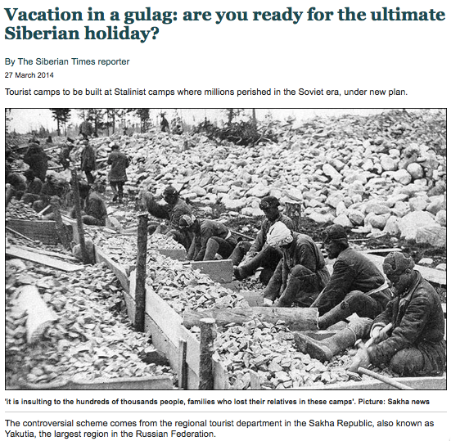
Failed Utopia: Social and Economic Organization
Max Weber: “Wherever bureaucracy gained the upper hand… it did not disappear…. State bureaucracy would rule alone if private capitalism were eliminated. The private and public bureaucracies, which now check one another to a degree, would be merged into a single hierarchy.
“This would be similar to the situation in ancient Egypt, but it would occur in a much more rational—and hence unbreakable—form… the shell of bondage which men will perhaps be forced to inhabit as powerless as the fellahs of ancient Egypt. Who would want to deny that such a potentiality lies in the womb of the future?…”
0:40
Notes:
The final judgment has to be German sociologist Max Weber's:
>Wherever bureaucracy gained the upper hand… it did not disappear…. State bureaucracy would rule alone if private capitalism were eliminated. The private and public bureaucracies, which now check one another to a degree, would be merged into a single hierarchy.
>This would be similar to the situation in ancient Egypt, but it would occur in a much more rationalized—and hence unbreakable—form… The shell of bondage which men will perhaps be forced to inhabit as powerless as the fellahs of ancient Egypt. Who would want to deny that such a potentiality lies in the womb of the future?

Slide 27
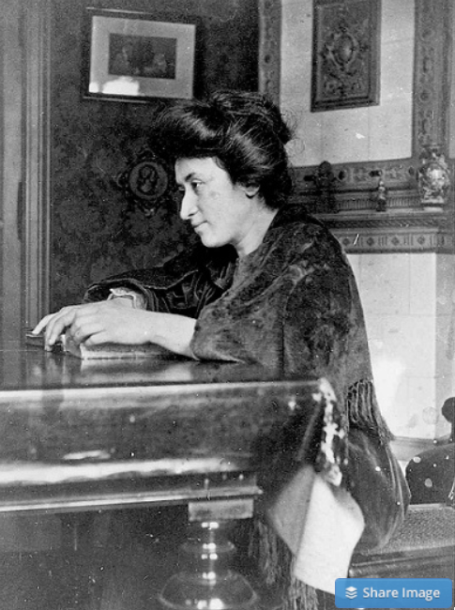
Failed Utopia: Politics
Rosa Luxemburg: “The tacit assumption underlying the Lenin-Trotsky theory of dictatorship is this: that the socialist transformation is something for which a ready-made formula lies completed in the pocket of the revolutionary party…. We [do] know more or less what we must eliminate…
“But when it comes to the nature of the thousand concrete, practical measures, large and small, necessary to introduce socialist principles into economy, law and all social relationships, there is no key in any socialist party program or textbook. That is not a shortcoming but rather the very thing that makes scientific socialism superior to the utopian varieties…”
What did Lenin do? The German war economy…
1:24
Notes:
And the final judgment has to be that of murdered German communist Rosa Luxemburg:
>The tacit assumption underlying the Lenin-Trotsky theory of dictatorship is this: that the socialist transformation is something for which a ready-made formula lies completed in the pocket of the revolutionary party…. We [do] know more or less what we must eliminate…
>But when it comes to the nature of the thousand concrete, practical measures, large and small, necessary to introduce socialist principles into economy, law and all social relationships, there is no key in any socialist party program or textbook. That is not a shortcoming but rather the very thing that makes scientific socialism superior to the utopian varieties…
That vision was 100% counter to the only way that Lenin knew to run his society: a dictatorship of the inner party because there was no proletariat mass base to serve even as a cadre for any form of open society politics, and the German war economy because Lenin had no idea of what else to do if he were going to eliminate the market.

Slide 28
Failed Utopia: Politics II
Rosa Luxemburg: “In place of… general, popular elections, Lenin and Trotsky have laid down the soviets…. Public life gradually falls asleep, a few dozen party leaders of inexhaustible energy and boundless experience direct and rule… meetings… [that] approve proposed resolutions unanimously… the dictatorship of a handful of politicians…. Such conditions must inevitably cause a brutalization of public life: attempted assassinations, shooting of hostages, etc…”
0:35
Notes:
And so, Red Rosa wrote:
>In place of… general, popular elections, Lenin and Trotsky have laid down the soviets…. Public life gradually falls asleep, a few dozen party leaders of inexhaustible energy and boundless experience direct and rule… meetings… [that] approve proposed resolutions unanimously… the dictatorship of a handful of politicians…. Such conditions must inevitably cause a brutalization of public life: attempted assassinations, shooting of hostages, etc…
She foresaw it. But she did not foresee half of it.

Slide 29
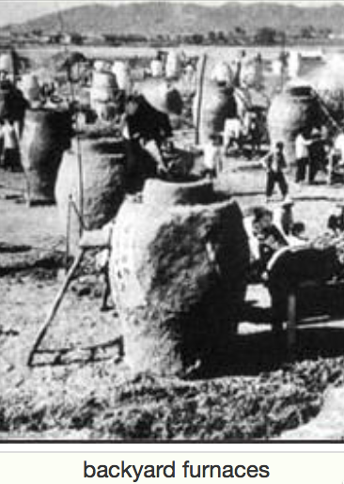
Failed Utopia: The Butcher’s Bill
Russian Civil War: 3M?
Collectivization of agriculture: 10M?
Great Terror: 2M?
Post-WWII purge: 2M?
Anti-landlordism: 4M?
Collectivization: 4M?
Great Leap Forward famine: 50M?
Cultural Revolution: 5M?
Pol Pot: 1.5M
Kim Dynasty: ????
1:24
Notes:
The butcher's bill: 3 million in the Russian Civil War. 10 million in the collectivization of agriculture. 2 million in Stalin's Great Terror against those who have been insufficiently enthusiastic about his leadership. Being a member of the inner party of the Soviet Union was the most hazardous place to be. 2 million in the post World War II purge. In China, 4 million in the anti-landlordism campaign. In China, 4 million in the collectivization of agriculture and the reenserfment of the peasantry. In China, 50 million in the famine of the Great Leap Forward: the regime took no steps to ease and in fact many steps to accentuate the famine because nobody but Peng Dehuai dared to tell Mao that there was going to be a famine. 5 million dead in the Cultural Revolution: we really do not know. Pol Pot and his Khmer Rouge got 1.5 million. And we do not know the murders of the Kim dynasty in North Korea.

Slide 30
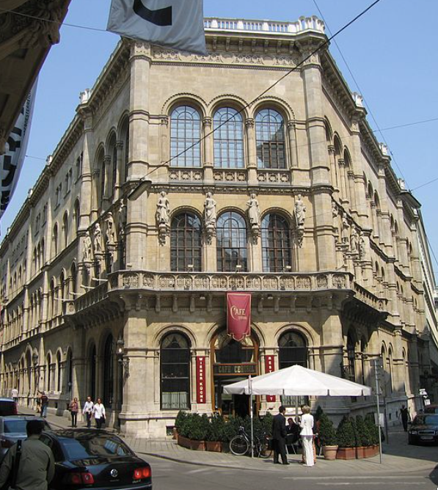
Failed Utopia: The Costs of the “Experiment”
Guenther Roth: “Weber and Schumpeter... had their famous falling-out in a Viennese coffeehouse in 1918. Weber, ‘who took nothing lightly,’ and Schumpeter, who ‘took nothing hard,’ recalled Somary who witnessed the scene, clashed over the Russian Revolution.
“Schumpeter welcomed it as a laboratory experiment…. For Weber it was going to be ‘a laboratory heaped with human corpses.’ When an enraged Weber stormed out, a smiling Schumpeter remarked: ‘How can someone carry on like that in a coffeehouse?’—the proper place for irony, never seriousness…”
0:35
Notes:
There is a strange and grim story told by sociologist Gunther Roth:
>Weber and Schumpeter... had their famous falling-out in a Viennese coffeehouse in 1918. Weber, ‘who took nothing lightly,’ and Schumpeter, who ‘took nothing hard,’ recalled Somary who witnessed the scene, clashed over the Russian Revolution. Schumpeter welcomed it as a laboratory experiment…. For Weber it was going to be ‘a laboratory heaped with human corpses.’ When an enraged Weber stormed out, a smiling Schumpeter remarked: ‘How can someone carry on like that in a coffeehouse?’—the proper place for irony, never seriousness…

Slide 31
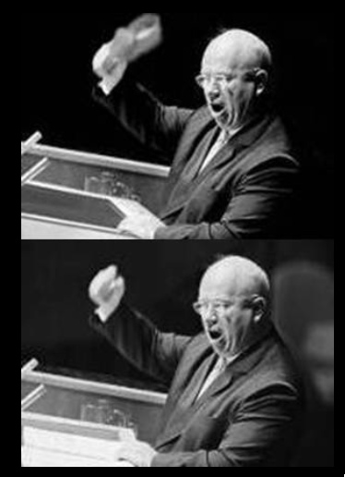
Failed Utopia: Our Friend Nikita Sergeyevitch
Francis Spufford: “So much blood, and only one justification for it…. If it had been all prologue, all only the last spasms of death in the old, cruel world…. Today the radio was reporting… Prague….
“He fumbled with the tape machine… found the RECORD key…. ‘Paradise’, he told the wheat field in baffled fury: ‘is a place where people want to end up, not a place they run from. What kind of socialism is that? What kind of shit is that, when you have to keep people in chains. What kind of social order? What kind of paradise?…’
“And then… the retired monster sat very still on the bench by the field…”
1:17
Notes:
Novelist Francis Spufford tries to enter the mind of Nikita Sergeyevitch Khrushchev, paramount leader of the Soviet Union from 1956 to 1964, in his retirement. Khrushchev was a monster, but he was a monster who believed that he was genuinely building a utopia, and that his monstrous deeds would be forgiven or were expiated or were necessary in order to build that utopia. Or so Khrushchev believed in his prime .Here is Spufford's guess at Khrushchev's thoughts in his retirement. From Francis Spufford's novel "Red Plenty":
>So much blood, and only one justification for it…. If it had been all prologue, all only the last spasms of death in the old, cruel world….
>Today the radio was reporting… Prague….
>He fumbled with the tape machine… found the RECORD key…. ‘Paradise’, he told the wheat field in baffled fury: ‘is a place where people want to end up, not a place they run from. What kind of socialism is that? What kind of shit is that, when you have to keep people in chains. What kind of social order? What kind of paradise?…’
>And then… the retired monster sat very still on the bench by the field…

Slide 32
Russia Sits Down
Successes of the Soviet Union:
By 1960, a roughly First World level of health, education, and other social indicators. However, followed by a relative decline.
The victory in World War II--and the heavy-industrial and military production that made this possible:
No market economy would ever have built a heavy industrial complex in Magnitogorsk.
And all praise to comrade Alexei Kosygin for the most extraordinary industrial relocation effort in history.
But Tukhachevsky would have done a lot better than Zhukov.
And if the Ukrainians had not had to learn to be anti-Nazi things would have gone much better.
Its relatively equal income distribution. Or was it a relatively equal income distribution?
The attainment of military-strategic parity with the United States in the 1970s. But what do you have to believe about the world to see that as an achievement rather than as a mistaken waste of resources?
2:09
Notes:
If the last years of the 1900s saw China stand up, they also saw Russia sit down.
The Soviet Union and its regime did have some things that could count as successes.
By 1960 it had a roughly 1st world level of health, education, and other social indicators. Its material poverty and its political dysfunction and tyranny were not matched by a similar degree of sociological dysfunction.
It had the victory in World War II and it had the heavy industrial and military production that made this victory possible. No market economy would have built a heavy industrial complex in Magnitogorsk. In fact no one but a paranoid madman would've built a heavy industrial complex in Magnitogorsk. Yet the heavy industrial complex in Magnitogorsk was essential in saving the world from the Nazis. And all praise to comrade Aleksey Kosygin for the most extraordinary industrial relocation effort in history in the first six months of World War II's eastern front.
But Marshall Tukhachevsky—purged by Stalin for having been too competent and too popular—would have done a lot better at commanding the armies than those able to flatter and survive under Stalin, even Zhukov.
And if the Ukrainians had not had to painfully learn that, hard as it might be to believe, being ruled by the Nazis was much worse than being ruled by even Stalin, things would've gone much much better.
The relatively equal income distribution of the Soviet Union is a plus. Or was it a relatively equal income distribution? It is hard to even think about what the real dimensions of inequality were in a society simultaneously as poor, as technologically capable, as corrupt, and as patronage network-dominated as the Soviet Union was.
The attainment of military-strategic parity with the United States in the 1970s was an accomplishment about which the Soviet Union was very very proud indeed. But what do you have to believe about the world to see that as an achievement rather than as a mistaken waste of resources?

Slide 33
Failures of the USSR
The Soviet growth rate was not impressively high when seen in a world context....
Even before 1917, the Russian economy had taken off…
The increased output achieved under the Communists was limited to steel, machinery, and military equipment.... The welfare of the working class... would have been better served by... capitalism....
The collectivization of agriculture... is a particularly vicious example....
Soviet socialism was economically irrational... driven by ideology, bureaucratic infighting, and despotic caprice… massive misallocation....
The growth slowdown after 1970 showed the ultimate weakness of socialism: while it could function in a mediocre way to build... smokestack industries... it was incapable of the sustained technological advance required for the postindustrial age...
1:23
Notes:
The failures of the Soviet Union loom much larger: The Soviet growth rate was not impressively high when seen in a world context. Even before 1917, the Russian economy had taken off. It is not at all clear that GDP was higher at any point under Soviet rule than had Lenin simply sat down and let Russia rule itself, democratically or semi-democratically. The increased output achieved under the Communists was limited to steel, machinery, and military equipment. The welfare of the working class would have been better served by capitalism.
The collectivization of agriculture is a particularly vicious example of Soviet dysfunction, terror, mass murder, and dystopia.
Soviet socialism was economically irrational: driven by ideology, bureaucratic infighting, and despotic caprice, with massive misallocations. The growth slowdown after 1970 showed the ultimate weakness of socialism: It could function in a mediocre way to build smokestack industries. But it was incapable of the sustained technological advance required for the postindustrial age, or indeed to deliver a high level of material well being to its subjects in the industrial age.

Slide 34
Robert Allen’s Case
Robert Allen:
“[In Britain] private property and… representative government... was the basis of civil society independent of the state.... [In Russia] the "rule of law" was a tool by which the tsar and nobles exploited the peasants rather than an impartial umpire…. Tsarist Russia [thus] lacked the social, legal and economic institutions that theorists of economic growth have argued are prerequisites for capitalist development. Indeed, much of the rest of the world lacked--and still lacks--this as well....
“Two responses are possible... create the missing prerequisites... create substitutes.... Russia's path to industrial society was based on the state's creating policies and institutions to substitute.... In the absence of the communist revolution and the Five-Year Plans, Russia would have remained as backward as much of Latin America or, indeed, South Asia. That fate was avoided by Stalin's economic institutions…”
Resource mobilization is not productivity-frontier post-industrial market capitalist development. But it is resource mobilization
1:32
Notes:
The brilliant economic historian Robert Allen tries to make the case for the Soviet Union's economy. It is not clear to me why. It seems to me he just gets hypnotized by the challenge of making the argument. Robert Allen:
>[In Britain] private property and… representative government... was the basis of civil society independent of the state.... [In Russia] the "rule of law" was a tool by which the tsar and nobles exploited the peasants rather than an impartial umpire…. Tsarist Russia [thus] lacked the social, legal and economic institutions that theorists of economic growth have argued are prerequisites for capitalist development. Indeed, much of the rest of the world lacked—and still lacks—this as well....
>Two responses are possible... create the missing prerequisites... create substitutes.... Russia's path to industrial society was based on the state's creating policies and institutions to substitute.... In the absence of the communist revolution and the Five-Year Plans, Russia would have remained as backward as much of Latin America or, indeed, South Asia. That fate was avoided by Stalin's economic institutions…
In short, resource mobilization is not productivity-frontier post-industrial market capitalist development. But it is resource mobilization. And resource mobilization is something. Many colonized and post-colonial societies failed even to accomplish resource mobilization. The Soviet Union succeeded in doing so.

Slide 35
Robert Allen’s Case II
Robert Allen:
Pre-October Revolution growth "a one-off resource boom with a veneer of some tariff-induced industrialization.” Russia was headed for a Latin American or South Asian destiny.
You needed a Big Push, and heavy industry was the Turnpike.
Planning could coordinate a Big Push to replicate the industrial structure you know you want to have.
Russia was saved from India's fate by a rapid demographic transition fueled primarily by the large scale emancipation of women.
Rapid industrialization driven by resource mobilization.
A post-Stalin slowdown was due to (a) the requirements of military spending and (b) "hare-brained schemes”.
But those were baked into the system, right? You cannot take the system’s successes and ignore its failures.
2:29
Notes:
To summarize Bob Allen's argument:
• Pre-October Revolution growth "a one-off resource boom with a veneer of some tariff-induced industrialization.” Russia was headed for a Latin American or South Asian destiny.
• You needed a Big Push, and heavy industry was the Turnpike.
• Planning could coordinate a Big Push to replicate the industrial structure you know you want to have.
• Russia was saved from India's fate by a rapid demographic transition fueled primarily by the large scale emancipation of women.
• Rapid industrialization driven by resource mobilization.
• A post-Stalin slowdown was due to (a) the requirements of military spending and (b) "hare-brained schemes”.
But those were baked into the system, right? You cannot take the system’s successes and ignore its failures. I simply do not find Allen convincing here.

Slide 36
Market Organization Matters a Lot
We have covered this enormously…
The lesson I draw from this tale is that—in contrast to, say, Soviet Georgia and Kazakhstan—Ukraine and Russia (and much more so Lithuania, Latvia, Estonia, and Leningrad Oblast) should have looked like western Europe: Finland and Sweden at best, Italy and Spain at worst, when the Iron Curtain fell if the Soviet economy had been a “success:
Rick Ericson:
“Prices… used for measurement, accounting, and control purposes”: i.e., not for incentives.
“Prices provide irrelevant or incorrect information about relative values and scarcities”.
“The traditional Soviet economic system is very good at mobilizing scarce resources and concentrating on a few clear, well-defined objectives that can be expressed in measurable, quantitative, and communicable terms, and that yield large observable changes as outcomes…”
1:15
Notes:
The bottom-line lesson I draw from this tale is that—in contrast to, say, Soviet Georgia and Kazakhstan—Ukraine and Russia (and much more so Lithuania, Latvia, Estonia, and Leningrad Oblast) should have looked like western Europe: Finland and Sweden at best, Italy and Spain at worst, when the Iron Curtain fell if the Soviet economy had been a “success:
I quote my teacher Rick Ericson:
• “Prices… used for measurement, accounting, and control purposes”: i.e., not for incentives.
• “Prices provide irrelevant or incorrect information about relative values and scarcities”.
• “The traditional Soviet economic system is very good at mobilizing scarce resources and concentrating on a few clear, well-defined objectives that can be expressed in measurable, quantitative, and communicable terms, and that yield large observable changes as outcomes…”

Slide 37
“Peaceful Competition”
N.S. Khrushchev (1958):
“Must we, in this period of the flourishing of human genius which is penetrating the secrets of nature and harnessing its mighty forces, put up with the preservation of relations that existed between people when man was still a beast?…
“Time is a good adviser, or as the Russian people say, ‘Take counsel of one's pillow’. This is a wise saying…. We shall do everything we can to tilt the barometer's hand away from ‘Storm’ and even from ‘Changeable’ to show ‘Fine.’
“I am confident, comrades, that… when the socialist camp has some one billion people and tremendous productive potential, when the Soviet Union has reached great heights in industry and agriculture, science, technology and culture, we can do a lot for the sake of peace.
“In our actions we rely on reason, on truth, on the support of all the people. Moreover, we rely on our great potential. And let it be known to those who want to continue the cold war so as to turn it sooner or later into a shooting war, that in our time only a madman can start a war and he himself will perish in its flames…”
Russia and its empire’s destinies after the 1989 fall of the Iron Curtain we will leave to later in the course…
1:25
Notes:
But I prefer to end this on a positive note. Let me quote the monster N.S. Khrushchev, paramount leader of the Soviet Union from 1956 to 1964, at his best, back in 1958:
>Must we, in this period of the flourishing of human genius which is penetrating the secrets of nature and harnessing its mighty forces, put up with the preservation of relations that existed between people when man was still a beast?…
>Time is a good adviser, or as the Russian people say, ‘Take counsel of one's pillow’. This is a wise saying…. We shall do everything we can to tilt the barometer's hand away from ‘Storm’ and even from ‘Changeable’ to show ‘Fine.’
>I am confident, comrades, that… when the socialist camp has some one billion people and tremendous productive potential, when the Soviet Union has reached great heights in industry and agriculture, science, technology and culture, we can do a lot for the sake of peace.
>In our actions we rely on reason, on truth, on the support of all the people. Moreover, we rely on our great potential. And let it be known to those who want to continue the cold war so as to turn it sooner or later into a shooting war, that in our time only a madman can start a war and he himself will perish in its flames…
Russia and its empire’s destinies after the 1989 fall of the Iron Curtain we will leave to later in the course…

Slide 38
Takeaways from This Time
The Cold War: Lecture & Ch 15
Give me five takeaways from this lecture…

Slide 39
Notes: What Was Unconvincing Today?
Mistakes and unclarities: typos, wordos, and mindos…
In the DRAFT textbook?
In the lecture?

Slide 40
Catch Our Breath…
Ask a couple of questions?
Make a couple of comments?
Any more readings to recommend?

